Slide 1
Clustering validation: Silhouette Coefficient
CSCI 347
Adiesha Liyana Ralalage

Slide 2
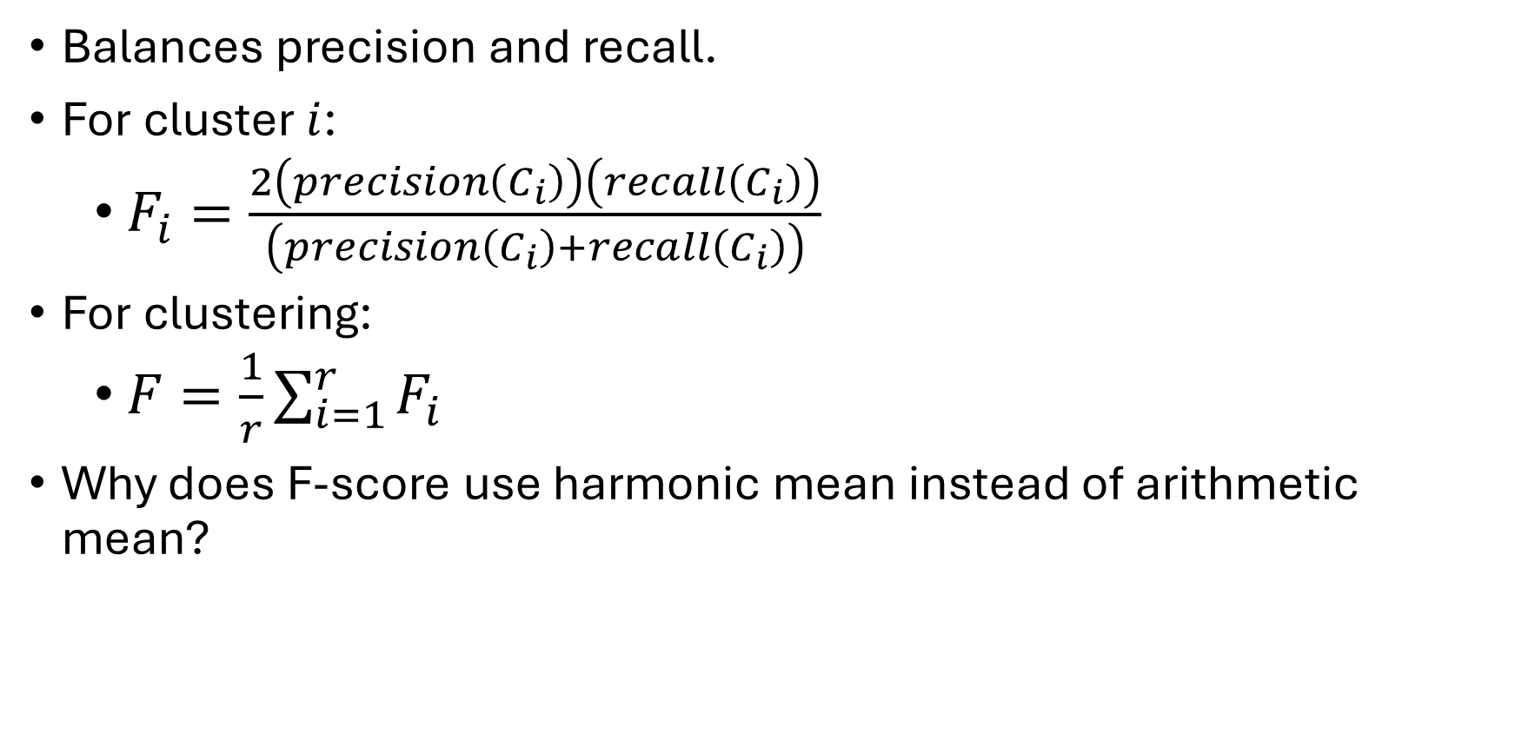
F-score
Balances precision and recall.
For cluster $i$:
$F_{i}=\frac{2\left(precision\left(C_{i}\right)\right)\left(recall\left(C_{i}\right)\right)}{\left(precision\left(C_{i}\right)+recall\left(C_{i}\right)\right)}$
For clustering:
$F=\frac{1}{r}\sum_{i=1}^{r}{F_{i}}$
Why does F-score use harmonic mean instead of arithmetic mean?

Slide 3
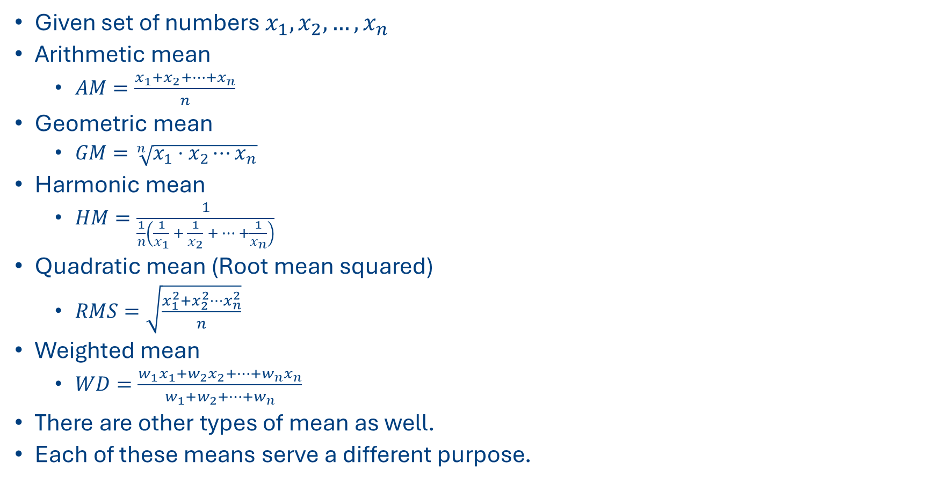
Different types of means
Given set of numbers $x_{1},x_{2},…, x_{n}$
Arithmetic mean
$AM=\frac{x_{1}+x_{2}+⋯+x_{n}}{n}$
Geometric mean
$GM=\sqrt[n]{x_{1}⋅x_{2}⋯x_{n}}$
Harmonic mean
$HM=\frac{1}{\frac{1}{n}\left(\frac{1}{x_{1}} + \frac{1}{x_{2}} + ⋯ +\frac{1}{x_{n}}\right)}$
Quadratic mean (Root mean squared)
$RMS=\sqrt{\frac{x_{1}^{2}+x_{2}^{2}⋯x_{n}^{2}}{n}}$
Weighted mean
$WD=\frac{{w_{1}x}_{1}+w_{2}x_{2}+⋯+{w_{n}x}_{n}}{w_{1}+w_{2}+⋯+w_{n}}$
There are other types of mean as well.
Each of these means serve a different purpose.

Slide 4
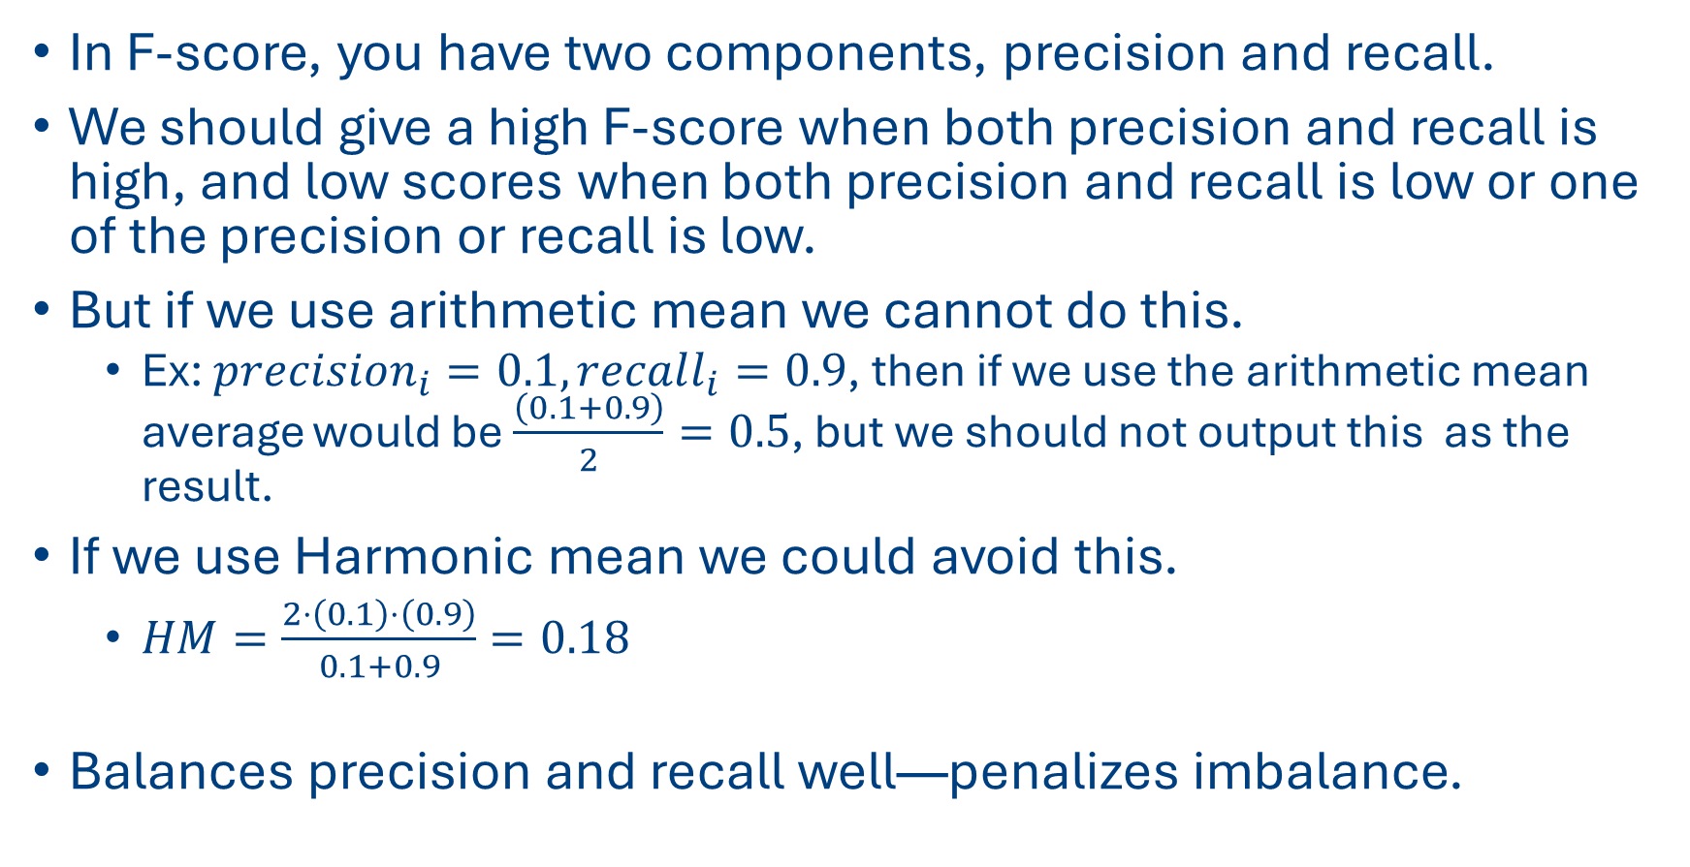
Different types of means
In F-score, you have two components, precision and recall.
We should give a high F-score when both precision and recall is high, and low scores when both precision and recall is low or one of the precision or recall is low.
But if we use arithmetic mean we cannot do this.
Ex: $precision_{i}=0.1, recall_{i}=0.9$, then if we use the arithmetic mean average would be $\frac{\left(0.1+0.9\right)}{2}=0.5$, but we should not output this as the result.
If we use Harmonic mean we could avoid this.
$HM=\frac{2⋅\left(0.1\right)⋅\left(0.9\right)}{0.1+0.9}=0.18$
Balances precision and recall well—penalizes imbalance.

Slide 5
SILHOUETTE COEFFICIENT
Internal measure.
Useful when you do not have the ground-truth (which is typically the case)
Notes:
where μin(xi ) is the mean distance from xi to points in its own cluster ˆyi :
nd μmin out (xi ) is the mean of the distances from xi to points in the closest cluster:

Slide 6
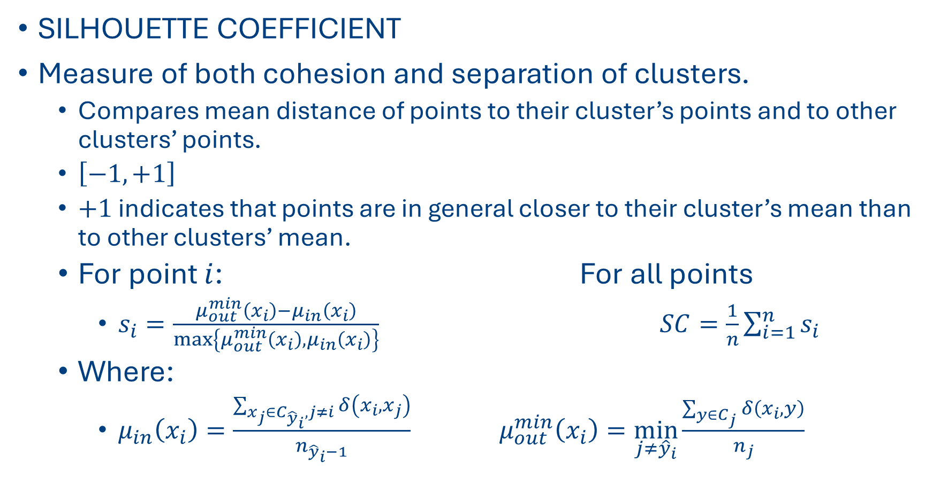
SILHOUETTE COEFFICIENT
SILHOUETTE COEFFICIENT
Measure of both cohesion and separation of clusters.
Compares mean distance of points to their cluster’s points and to other clusters’ points.
$\left[−1,+1\right]$
$+1$ indicates that points are in general closer to their cluster’s mean than to other clusters’ mean.
For point $i$: For all points
$s_{i}=\frac{μ_{out}^{min}\left(x_{i}\right)−μ_{in}\left(x_{i}\right)}{\max\left\{μ_{out}^{min}\left(x_{i}\right), μ_{in}\left(x_{i}\right)\right\}}$ $SC=\frac{1}{n}\sum_{i=1}^{n}{s_{i}}$
Where:
$μ_{in}\left(x_{i}\right)=\frac{\sum_{x_{j}∈C_{{\hat{y}}_{i}},j≠i}^{ }{δ\left(x_{i}, x_{j}\right)}}{n_{{\hat{y}}_{i}−1}}$ $μ_{out}^{min}\left(x_{i}\right)=\min_{j≠{\hat{y}}_{i}}{\frac{\sum_{y∈C_{j}}^{ }{δ\left(x_{i}, y\right)}}{n_{j}}}$
Notes:
where μin(xi ) is the mean distance from xi to points in its own cluster ˆyi :
nd μmin out (xi ) is the mean of the distances from xi to points in the closest cluster:

Slide 7
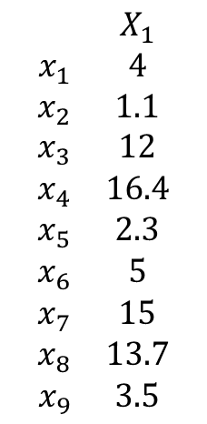
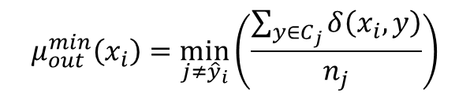
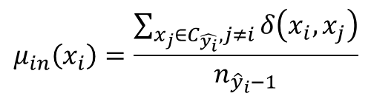
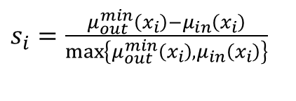
Silhouette coefficient (Ground truth is not known)
$$\begin{matrix} & X_{1} \\ x_{1} & 4 \\ x_{2} & 1.1 \\ x_{3} & 12 \\ x_{4} & 16.4 \\ x_{5} & 2.3 \\ x_{6} & 5 \\ x_{7} & 15 \\ x_{8} & 13.7 \\ x_{9} & 3.5\end{matrix}$$
$$𝒞=\left\{C_{1},C_{2}\right\}=\left\{\left\{x_{2},x_{5}\right\},\left\{x_{1},x_{3},x_{4},x_{6},x_{7},x_{8},x_{9}\right\}\right\}$$
-1
0
1
2
3
4
5
6
7
8
9
10
11
12
13
14
15
16
17
18
19
20
21
22
$s_{i}=\frac{μ_{out}^{min}\left(x_{i}\right)−μ_{in}\left(x_{i}\right)}{\max\left\{μ_{out}^{min}\left(x_{i}\right), μ_{in}\left(x_{i}\right)\right\}}$
$$μ_{in}\left(x_{i}\right)=\frac{\sum_{x_{j}∈C_{\hat{y_{i}}},j≠i}^{ }{δ\left(x_{i}, x_{j}\right)}}{n_{{\hat{y}}_{i}−1}}$$
$$μ_{out}^{min}\left(x_{i}\right)=\min_{j≠{\hat{y}}_{i}}\left(\frac{\sum_{y∈C_{j}}^{ }{δ\left(x_{i}, y\right)}}{n_{j}}\right)$$

Slide 8
Silhouette coefficient (Ground truth is not known)
$$\begin{matrix} & X_{1} \\ x_{1} & 4 \\ x_{2} & 1.1 \\ x_{3} & 12 \\ x_{4} & 16.4 \\ x_{5} & 2.3 \\ x_{6} & 5 \\ x_{7} & 15 \\ x_{8} & 13.7 \\ x_{9} & 3.5\end{matrix}$$
$$𝒞=\left\{C_{1},C_{2}\right\}=\left\{\left\{x_{2},x_{5}\right\},\left\{x_{1},x_{3},x_{4},x_{6},x_{7},x_{8},x_{9}\right\}\right\}$$
-1
0
1
2
3
4
5
6
7
8
9
10
11
12
13
14
15
16
17
18
19
20
21
22
$s_{i}=\frac{μ_{out}^{min}\left(x_{i}\right)−μ_{in}\left(x_{i}\right)}{\max\left\{μ_{out}^{min}\left(x_{i}\right), μ_{in}\left(x_{i}\right)\right\}}$
$$μ_{in}\left(x_{i}\right)=\frac{\sum_{x_{j}∈C_{\hat{y_{i}}},j≠i}^{ }{δ\left(x_{i}, x_{j}\right)}}{n_{{\hat{y}}_{i}−1}}$$
$$μ_{out}^{min}\left(x_{i}\right)=\min_{j≠{\hat{y}}_{i}}\left(\frac{\sum_{y∈C_{j}}^{ }{δ\left(x_{i}, y\right)}}{n_{j}}\right)$$

Slide 9
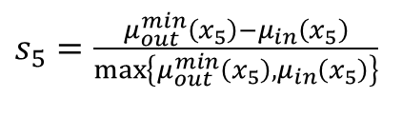
Silhouette coefficient (Ground truth is not known)
$$\begin{matrix} & X_{1} \\ x_{1} & 4 \\ x_{2} & 1.1 \\ x_{3} & 12 \\ x_{4} & 16.4 \\ x_{5} & 2.3 \\ x_{6} & 5 \\ x_{7} & 15 \\ x_{8} & 13.7 \\ x_{9} & 3.5\end{matrix}$$
$$𝒞=\left\{C_{1},C_{2}\right\}=\left\{\left\{x_{2},x_{5}\right\},\left\{x_{1},x_{3},x_{4},x_{6},x_{7},x_{8},x_{9}\right\}\right\}$$
-1
0
1
2
3
4
5
6
7
8
9
10
11
12
13
14
15
16
17
18
19
20
21
22
$s_{i}=\frac{μ_{out}^{min}\left(x_{i}\right)−μ_{in}\left(x_{i}\right)}{\max\left\{μ_{out}^{min}\left(x_{i}\right), μ_{in}\left(x_{i}\right)\right\}}$
$$μ_{in}\left(x_{i}\right)=\frac{\sum_{x_{j}∈C_{\hat{y_{i}}},j≠i}^{ }{δ\left(x_{i}, x_{j}\right)}}{n_{{\hat{y}}_{i}−1}}$$
$$μ_{out}^{min}\left(x_{i}\right)=\min_{j≠{\hat{y}}_{i}}\left(\frac{\sum_{y∈C_{j}}^{ }{δ\left(x_{i}, y\right)}}{n_{j}}\right)$$
$$μ_{out}^{min}\left(x_{5}\right)=\frac{δ\left(x_{5},x_{1}\right)+δ\left(x_{5},x_{3}\right)+δ\left(x_{5},x_{4}\right)+δ\left(x_{5},x_{6}\right)+δ\left(x_{5},x_{7}\right)+δ\left(x_{5},x_{8}\right)+δ\left(x_{5},x_{9}\right)}{7}$$
$s_{5}=\frac{μ_{out}^{min}\left(x_{5}\right)−μ_{in}\left(x_{5}\right)}{\max\left\{μ_{out}^{min}\left(x_{5}\right), μ_{in}\left(x_{5}\right)\right\}}$
$$μ_{out}^{min}\left(x_{5}\right)=\frac{1.7+9.7+14.1+2.7+12.7+11.4+1.2}{7}=7.64$$

Slide 10

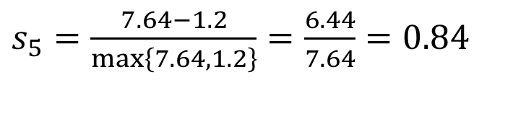
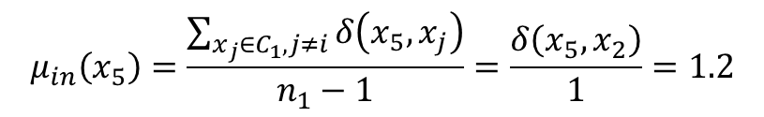
Silhouette coefficient (Ground truth is not known)
$$\begin{matrix} & X_{1} \\ x_{1} & 4 \\ x_{2} & 1.1 \\ x_{3} & 12 \\ x_{4} & 16.4 \\ x_{5} & 2.3 \\ x_{6} & 5 \\ x_{7} & 15 \\ x_{8} & 13.7 \\ x_{9} & 3.5\end{matrix}$$
$$𝒞=\left\{C_{1},C_{2}\right\}=\left\{\left\{x_{2},x_{5}\right\},\left\{x_{1},x_{3},x_{4},x_{6},x_{7},x_{8},x_{9}\right\}\right\}$$
-1
0
1
2
3
4
5
6
7
8
9
10
11
12
13
14
15
16
17
18
19
20
21
22
$s_{i}=\frac{μ_{out}^{min}\left(x_{i}\right)−μ_{in}\left(x_{i}\right)}{\max\left\{μ_{out}^{min}\left(x_{i}\right), μ_{in}\left(x_{i}\right)\right\}}$
$$μ_{in}\left(x_{i}\right)=\frac{\sum_{x_{j}∈C_{\hat{y_{i}}},j≠i}^{ }{δ\left(x_{i}, x_{j}\right)}}{n_{{\hat{y}}_{i}−1}}$$
$$μ_{out}^{min}\left(x_{i}\right)=\min_{j≠{\hat{y}}_{i}}\left(\frac{\sum_{y∈C_{j}}^{ }{δ\left(x_{i}, y\right)}}{n_{j}}\right)$$
$$μ_{out}^{min}\left(x_{5}\right)=7.64$$
$$μ_{in}\left(x_{5}\right)=\frac{\sum_{x_{j}∈C_{1},j≠i}^{ }{δ\left(x_{5}, x_{j}\right)}}{n_{1}−1}=\frac{δ\left(x_{5},x_{2}\right)}{1}=1.2$$
$s_{5}=\frac{μ_{out}^{min}\left(x_{5}\right)−μ_{in}\left(x_{5}\right)}{\max\left\{μ_{out}^{min}\left(x_{5}\right), μ_{in}\left(x_{5}\right)\right\}}$
$s_{5}=\frac{7.64−1.2}{\max\left\{7.64, 1.2\right\}}=\frac{6.44}{7.64}=0.84$

Slide 11
Silhouette coefficient (Ground truth is not known)
$$\begin{matrix} & X_{1} \\ x_{1} & 4 \\ x_{2} & 1.1 \\ x_{3} & 12 \\ x_{4} & 16.4 \\ x_{5} & 2.3 \\ x_{6} & 5 \\ x_{7} & 15 \\ x_{8} & 13.7 \\ x_{9} & 3.5\end{matrix}$$
$$𝒞=\left\{C_{1},C_{2}\right\}=\left\{\left\{x_{2},x_{5}\right\},\left\{x_{1},x_{3},x_{4},x_{6},x_{7},x_{8},x_{9}\right\}\right\}$$
-1
0
1
2
3
4
5
6
7
8
9
10
11
12
13
14
15
16
17
18
19
20
21
22
$s_{i}=\frac{μ_{out}^{min}\left(x_{i}\right)−μ_{in}\left(x_{i}\right)}{\max\left\{μ_{out}^{min}\left(x_{i}\right), μ_{in}\left(x_{i}\right)\right\}}$
$$μ_{in}\left(x_{i}\right)=\frac{\sum_{x_{j}∈C_{\hat{y_{i}}},j≠i}^{ }{δ\left(x_{i}, x_{j}\right)}}{n_{{\hat{y}}_{i}−1}}$$
$$μ_{out}^{min}\left(x_{i}\right)=\min_{j≠{\hat{y}}_{i}}\left(\frac{\sum_{y∈C_{j}}^{ }{δ\left(x_{i}, y\right)}}{n_{j}}\right)$$

Slide 12
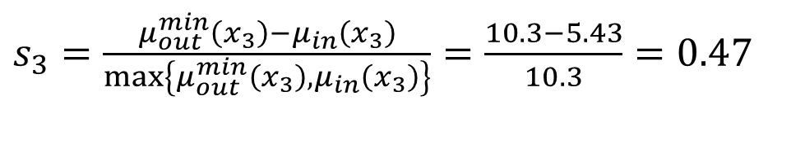

Silhouette coefficient (Ground truth is not known)
$$\begin{matrix} & X_{1} \\ x_{1} & 4 \\ x_{2} & 1.1 \\ x_{3} & 12 \\ x_{4} & 16.4 \\ x_{5} & 2.3 \\ x_{6} & 5 \\ x_{7} & 15 \\ x_{8} & 13.7 \\ x_{9} & 3.5\end{matrix}$$
$$𝒞=\left\{C_{1},C_{2}\right\}=\left\{\left\{x_{2},x_{5}\right\},\left\{x_{1},x_{3},x_{4},x_{6},x_{7},x_{8},x_{9}\right\}\right\}$$
-1
0
1
2
3
4
5
6
7
8
9
10
11
12
13
14
15
16
17
18
19
20
21
22
$s_{i}=\frac{μ_{out}^{min}\left(x_{i}\right)−μ_{in}\left(x_{i}\right)}{\max\left\{μ_{out}^{min}\left(x_{i}\right), μ_{in}\left(x_{i}\right)\right\}}$
$$μ_{out}^{min}\left(x_{3}\right)=\min_{j≠{\hat{y}}_{i}}\left(\frac{\sum_{y∈C_{j}}^{ }{δ\left(x_{i}, y\right)}}{n_{j}}\right)=\frac{δ\left(x_{3},x_{2}\right)+δ\left(x_{3},x_{5}\right)}{n_{1}}=\frac{10.9+9.7}{2}=10.3$$
$$μ_{in}\left(x_{3}\right)=\frac{\sum_{x_{j}∈C_{2},j≠i}^{ }{δ\left(x_{3}, x_{j}\right)}}{n_{2}−1}=\frac{δ\left(x_{3}, x_{1}\right)+δ\left(x_{3}, x_{4}\right)+δ\left(x_{3}, x_{6}\right)+δ\left(x_{3}, x_{7}\right)+δ\left(x_{3}, x_{8}\right)+δ\left(x_{3}, x_{9}\right)}{6}$$
$$μ_{in}\left(x_{3}\right)=\frac{8+4.4+7+3+1.7+8.5}{6}=5.43$$
$s_{3}=\frac{μ_{out}^{min}\left(x_{3}\right)−μ_{in}\left(x_{3}\right)}{\max\left\{μ_{out}^{min}\left(x_{3}\right), μ_{in}\left(x_{3}\right)\right\}}=\frac{10.3−5.43}{10.3}=0.47$

Slide 13
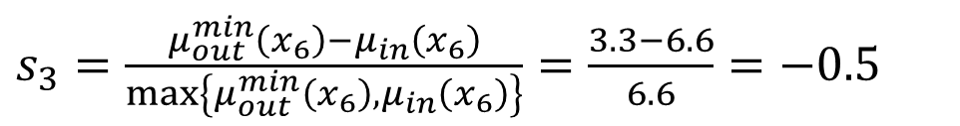

Silhouette coefficient (Ground truth is not known)
$$\begin{matrix} & X_{1} \\ x_{1} & 4 \\ x_{2} & 1.1 \\ x_{3} & 12 \\ x_{4} & 16.4 \\ x_{5} & 2.3 \\ x_{6} & 5 \\ x_{7} & 15 \\ x_{8} & 13.7 \\ x_{9} & 3.5\end{matrix}$$
$$𝒞=\left\{C_{1},C_{2}\right\}=\left\{\left\{x_{2},x_{5}\right\},\left\{x_{1},x_{3},x_{4},x_{6},x_{7},x_{8},x_{9}\right\}\right\}$$
-1
0
1
2
3
4
5
6
7
8
9
10
11
12
13
14
15
16
17
18
19
20
21
22
$s_{i}=\frac{μ_{out}^{min}\left(x_{i}\right)−μ_{in}\left(x_{i}\right)}{\max\left\{μ_{out}^{min}\left(x_{i}\right), μ_{in}\left(x_{i}\right)\right\}}$
$$μ_{out}^{min}\left(x_{6}\right)=\min_{j≠{\hat{y}}_{i}}\left(\frac{\sum_{y∈C_{j}}^{ }{δ\left(x_{i}, y\right)}}{n_{j}}\right)=\frac{δ\left(x_{6},x_{2}\right)+δ\left(x_{6},x_{5}\right)}{n_{1}}=\frac{3.9+2.7}{2}=3.3$$
$$μ_{in}\left(x_{3}\right)=\frac{\sum_{x_{j}∈C_{2},j≠i}^{ }{δ\left(x_{6}, x_{j}\right)}}{n_{2}−1}=\frac{δ\left(x_{6}, x_{1}\right)+δ\left(x_{3}, x_{6}\right)+δ\left(x_{6}, x_{4}\right)+δ\left(x_{6}, x_{7}\right)+δ\left(x_{6}, x_{8}\right)+δ\left(x_{6}, x_{9}\right)}{6}$$
$$μ_{in}\left(x_{3}\right)=\frac{1+7+11.4+10+8.7+1.5}{6}=6.6$$
$s_{3}=\frac{μ_{out}^{min}\left(x_{6}\right)−μ_{in}\left(x_{6}\right)}{\max\left\{μ_{out}^{min}\left(x_{6}\right), μ_{in}\left(x_{6}\right)\right\}}=\frac{3.3−6.6}{6.6}=−0.5$

Slide 14
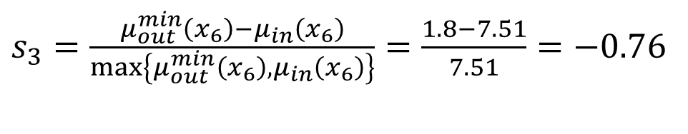
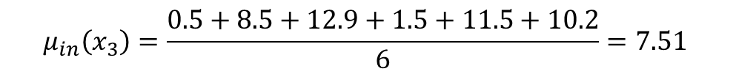
Silhouette coefficient (Ground truth is not known)
$$\begin{matrix} & X_{1} \\ x_{1} & 4 \\ x_{2} & 1.1 \\ x_{3} & 12 \\ x_{4} & 16.4 \\ x_{5} & 2.3 \\ x_{6} & 5 \\ x_{7} & 15 \\ x_{8} & 13.7 \\ x_{9} & 3.5\end{matrix}$$
$$𝒞=\left\{C_{1},C_{2}\right\}=\left\{\left\{x_{2},x_{5}\right\},\left\{x_{1},x_{3},x_{4},x_{6},x_{7},x_{8},x_{9}\right\}\right\}$$
-1
0
1
2
3
4
5
6
7
8
9
10
11
12
13
14
15
16
17
18
19
20
21
22
$s_{i}=\frac{μ_{out}^{min}\left(x_{i}\right)−μ_{in}\left(x_{i}\right)}{\max\left\{μ_{out}^{min}\left(x_{i}\right), μ_{in}\left(x_{i}\right)\right\}}$
$$μ_{out}^{min}\left(x_{1}\right)=\min_{j≠{\hat{y}}_{i}}\left(\frac{\sum_{y∈C_{j}}^{ }{δ\left(x_{i}, y\right)}}{n_{j}}\right)=\frac{δ\left(x_{9},x_{2}\right)+δ\left(x_{9},x_{5}\right)}{n_{1}}=\frac{2.4+1.2}{2}=1.8$$
$$μ_{in}\left(x_{3}\right)=\frac{\sum_{x_{j}∈C_{2},j≠i}^{ }{δ\left(x_{6}, x_{j}\right)}}{n_{2}−1}=\frac{δ\left(x_{9}, x_{1}\right)+δ\left(x_{9}, x_{3}\right)+δ\left(x_{9}, x_{4}\right)+δ\left(x_{9}, x_{6}\right)+δ\left(x_{9}, x_{7}\right)+δ\left(x_{9}, x_{8}\right)}{6}$$
$$μ_{in}\left(x_{3}\right)=\frac{0.5+8.5+12.9+1.5+11.5+10.2}{6}=7.51$$
$s_{3}=\frac{μ_{out}^{min}\left(x_{6}\right)−μ_{in}\left(x_{6}\right)}{\max\left\{μ_{out}^{min}\left(x_{6}\right), μ_{in}\left(x_{6}\right)\right\}}=\frac{1.8−7.51}{7.51}=−0.76$

Slide 15

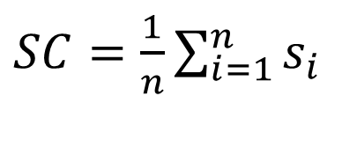
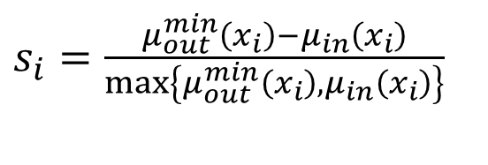
Silhouette coefficient (Ground truth is not known)
$$\begin{matrix} & X_{1} \\ x_{1} & 4 \\ x_{2} & 1.1 \\ x_{3} & 12 \\ x_{4} & 16.4 \\ x_{5} & 2.3 \\ x_{6} & 5 \\ x_{7} & 15 \\ x_{8} & 13.7 \\ x_{9} & 3.5\end{matrix}$$
$$𝒞=\left\{C_{1},C_{2}\right\}=\left\{\left\{x_{2},x_{5}\right\},\left\{x_{1},x_{3},x_{4},x_{6},x_{7},x_{8},x_{9}\right\}\right\}$$
-1
0
1
2
3
4
5
6
7
8
9
10
11
12
13
14
15
16
17
18
19
20
21
22
$s_{i}=\frac{μ_{out}^{min}\left(x_{i}\right)−μ_{in}\left(x_{i}\right)}{\max\left\{μ_{out}^{min}\left(x_{i}\right), μ_{in}\left(x_{i}\right)\right\}}$
$SC=\frac{1}{n}\sum_{i=1}^{n}{s_{i}}$
$$In this example, SC=0.2$$

Slide 16

Silhouette coefficient (Ground truth is not known)
$$\begin{matrix} & X_{1} \\ x_{1} & 4 \\ x_{2} & 1.1 \\ x_{3} & 12 \\ x_{4} & 16.4 \\ x_{5} & 2.3 \\ x_{6} & 5 \\ x_{7} & 15 \\ x_{8} & 13.7 \\ x_{9} & 3.5\end{matrix}$$
$$𝒞=\left\{C_{1},C_{2}\right\}=\left\{\left\{{x_{1},x}_{2},x_{5},x_{9}\right\},\left\{x_{3},x_{4}, {x_{6},x}_{7},x_{8}\right\}\right\}$$
-1
0
1
2
3
4
5
6
7
8
9
10
11
12
13
14
15
16
17
18
19
20
21
22
$s_{i}=\frac{μ_{out}^{min}\left(x_{i}\right)−μ_{in}\left(x_{i}\right)}{\max\left\{μ_{out}^{min}\left(x_{i}\right), μ_{in}\left(x_{i}\right)\right\}}$
$SC=\frac{1}{n}\sum_{i=1}^{n}{s_{i}}$
$$In this example, SC=0.57$$

Slide 17

Silhouette coefficient (Ground truth is not known)
$$\begin{matrix} & X_{1} \\ x_{1} & 4 \\ x_{2} & 1.1 \\ x_{3} & 12 \\ x_{4} & 16.4 \\ x_{5} & 2.3 \\ x_{6} & 5 \\ x_{7} & 15 \\ x_{8} & 13.7 \\ x_{9} & 3.5\end{matrix}$$
$$𝒞=\left\{C_{1},C_{2}\right\}=\left\{\left\{{x_{1},x}_{2},x_{5},x_{6},x_{9}\right\},\left\{x_{3},x_{4}, x_{7},x_{8}\right\}\right\}$$
-1
0
1
2
3
4
5
6
7
8
9
10
11
12
13
14
15
16
17
18
19
20
21
22
$s_{i}=\frac{μ_{out}^{min}\left(x_{i}\right)−μ_{in}\left(x_{i}\right)}{\max\left\{μ_{out}^{min}\left(x_{i}\right), μ_{in}\left(x_{i}\right)\right\}}$
$SC=\frac{1}{n}\sum_{i=1}^{n}{s_{i}}$
$$In this example, SC=0.80$$

Slide 18
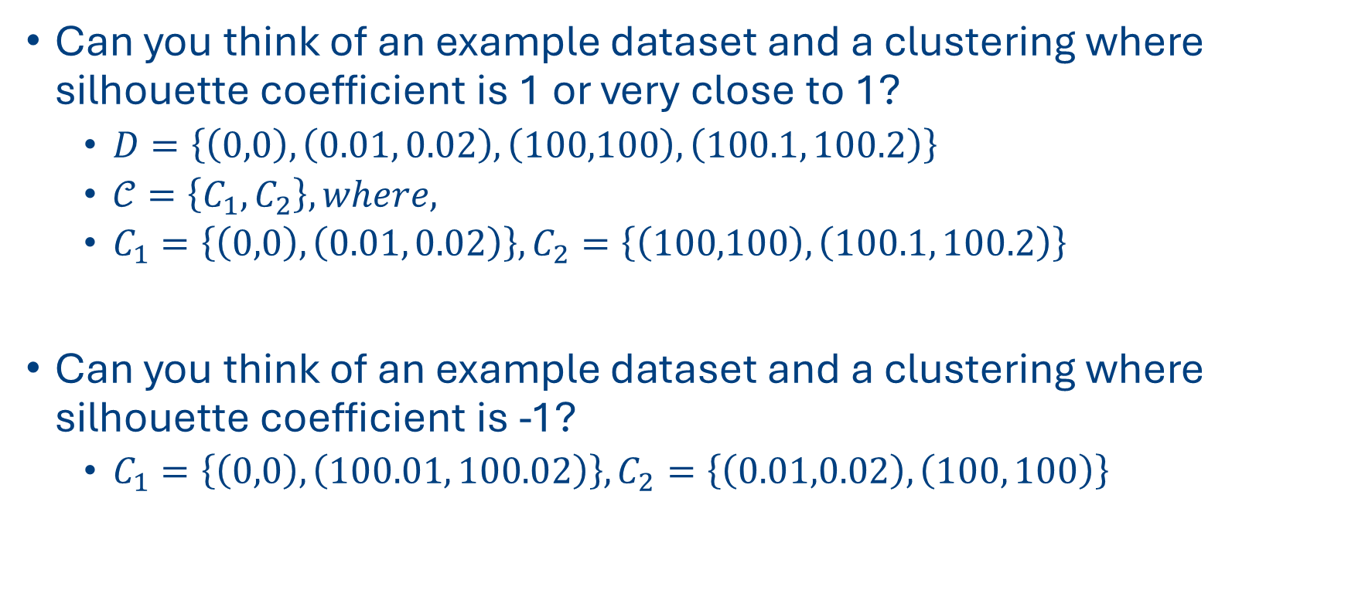
Question:
Can you think of an example dataset and a clustering where silhouette coefficient is 1 or very close to 1?
$D=\left\{\left(0,0\right), \left(0.01, 0.02\right),\left(100,100\right), \left(100.1, 100.2\right)\right\}$
$𝒞=\left\{C_{1},C_{2}\right\}, where,$
$C_{1}=\left\{\left(0,0\right), \left(0.01, 0.02\right)\right\}, C_{2}=\left\{\left(100,100\right), \left(100.1, 100.2\right)\right\}$
Can you think of an example dataset and a clustering where silhouette coefficient is -1?
$C_{1}=\left\{\left(0,0\right), \left(100.01, 100.02\right)\right\}, C_{2}=\left\{\left(0.01,0.02\right), \left(100, 100\right)\right\}$

